Slide 1
Lecture Four
The Future

Slide 2

Opportunity and Challenges

Slide 3

Opportunity and Difficulty
Much of what constitutes the opportunity of cybersecurity for space systems is based round the aspects of the space domain that also make it difficult to provide solutions for.
Will require not only an appreciation and understanding of the foundational issues but an ability to leverage them to inform cybersecurity R&D, implementations and operations.

Slide 4
Technical Difficulties
Execution requires expertise in cybersecurity and aerospace
Testing and evaluating solutions is extremely technical, expensive, and has limited capable institutions compared to traditional cybersecurity products
Gaining experience in the field is rare and difficult, but becoming easier
Managing resource utilization and risk mitigation has little precedent

Slide 5

Contrasting Space & SCADA / IoT
We get to pace the space industry vs coming in decades later
Many technologies resemble SCADA related tech, IoT, OT, but are more constrained
Investing in SCADA/IoT talent has high ROI due to customer base
Investing in aerospace expertise most be much more ROI conscious

Slide 6
Space Rated/Hardened/Resilient Parts
That’s right, sometimes normal off the shelf stuff passes enough testing to get launched into space
So, do I need to test my cybersecurity solution on expensive long lead space parts or no?
The answer is maybe, it depends
Radiation, latch ups & physical vs logical mitigations and impacts on cybersecurity implementation
Backups / Gold Images

Slide 7

Big (old) vs Small (new)
Big:
Vertically integrated
Provide their own solutions
Small
Outsourcing of test, evaluation, etc

Slide 8
Heritage is King, Heritage is Hard
Space customers and the industry as a whole are obsessed with heritage
It is expensive to put stuff into space
It s hard to put stuff into space
For SW there are more options for establishing heritage
ISS, rideshare, old / unused birds, colleges etc
For HW, this is a much harder problem, but establishing heritage here could be golden

Slide 9
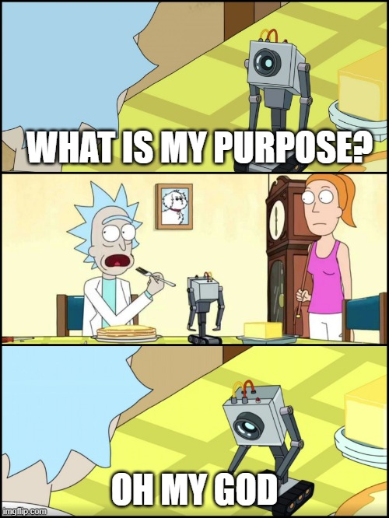
CYBERSECURITY…

Slide 10
The Challenge of Space System Cybersecurity: Architecture
Telemetry can be used for anomaly detection, just like on systems such as other critical infrastructure / SCADA
Marrying telemetry to traditional threat hunting is a novel-ish way to approach cybersecurity for space
Need to understand the potential folly in relying on standard data from the vehicle if it is compromised
Using something like visual tracking etc. maybe only reliable method to pare the two

Slide 11
Space Rating Cybersecurity
UAH SSD
STARGATE
IEEE Standard

Slide 12
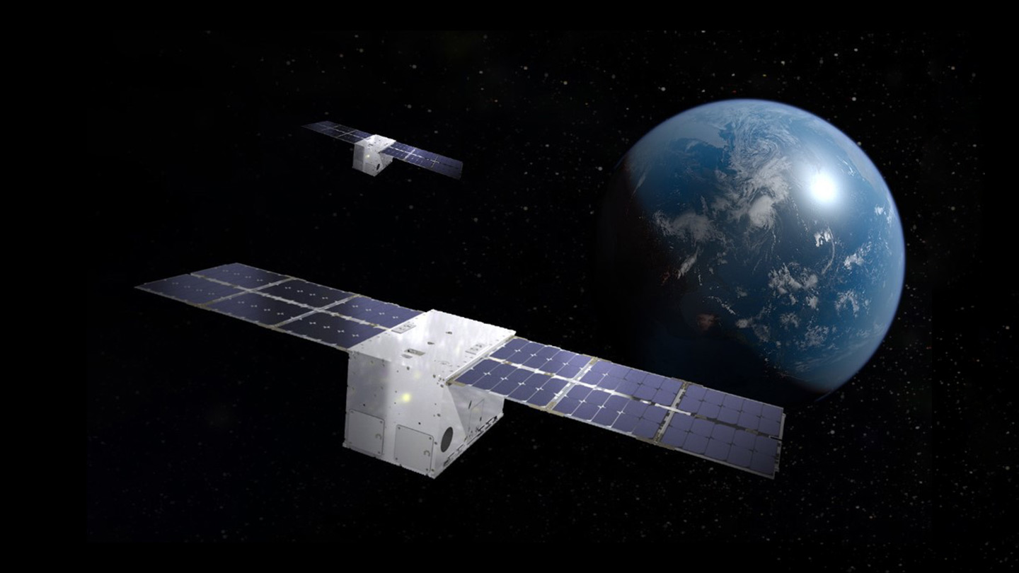
Space Rated Cybersecurity
The University of Alabama in Huntsville demonstrates cybersecurity software aboard a Lockheed Martin technology demonstrator CubeSat

Slide 13
The Small Satellite Defender
OCT 05, 2023, The University of Alabama in Huntsville (UAH) today announced that it developed a cybersecurity software for the U.S. Army Space and Missile Defense Command (USASMDC). The software began performance testing on one of Lockheed Martin’s (NYSE: LMT) In-space Upgrade Satellite System (LM LINUSS™) technology demonstrator CubeSats. The software, Small Satellite Defender, is an intrusion detection system designed for small satellites.
The Small Satellite Defender – created by UAH students, UAH Center for Cybersecurity Research and Education (CCRE) staff and USASMDC cybersecurity engineers – will continue to run for multiple weeks collecting data and periodically transmitting data to the ground station. The students are members of the Space Testing and Resiliency Simulation team, or STARS, who perform small satellite research and development for USASMDC
The Small Satellite Defender runs with relatively low power, monitors for satellite specific threats and requires very low bandwidth. The software is collecting data for multiple weeks and periodically transmitting the cyber status to the ground station. The initial test results indicate the Small Satellite Defender software performed as intended, and the application passed all in-flight tests.
https://www.uah.edu/news/news/the-university-of-alabama-in-huntsville-demonstrates-cybersecurity-software-aboard-a-lockheed-martin-technology-demonstrator-cubesat

Slide 14
Space Rating The Small Satellite Defender
Rating resource consumption
Aids in addressing system owner concerns
Command / configuration specific measurement
If HW, Self-reliant housekeeping
Can’t rely on SV protections
Data routing
Same as payload? As telemetry? As its own channel? Unique priority?

Slide 15
STARGATE
Fictional but possible space craft cyber operations tool made from LANtenna and Etherify tools.
Airgap jumping, segmentation defeating sniffer as well as potential bi-directional communications solution.
https://www.bankinfosecurity.com/lantenna-attacks-exploit-air-gapped-networks-via-ethernet-cables-a-17688
https://arxiv.org/pdf/2110.00104.pdf
https://lipkowski.com/etherify/
https://github.com/sq5bpf/etherify
https://www.rtl-sdr.com/snooping-network-traffic-from-lan-cables-with-an-rtl-sdr-or-hackrf/
https://www.rtl-sdr.com/etherify-transmitting-morse-code-via-raspberry-pi-ethernet-rf-leakage/

Slide 16
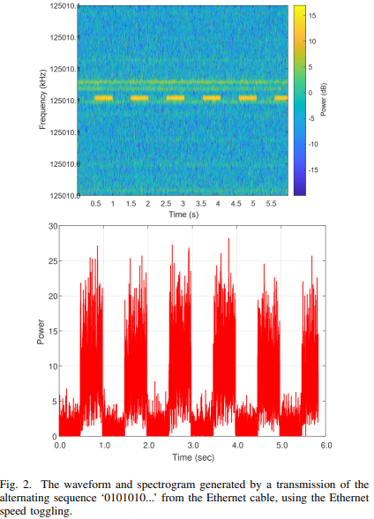
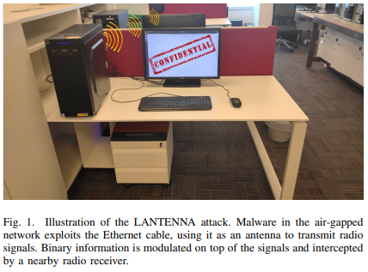
LANtenna
"Ethernet cable emits electromagnetic waves in the frequency bands of 125 MHz. Changing the adapter speed or turning it on and off makes it possible to regulate the electromagnetic radiation and its amplitude," says Guri.
In this case, data could be transmitted from an air-gapped computer through its Ethernet cable and received 200 cm apart, he says, adding that the signal was wrapped around 125.010 MHz.
His research also showcases how a standard software-defined radio receiver in the area could decode the information and pass it to the attacker using internet.

Slide 17
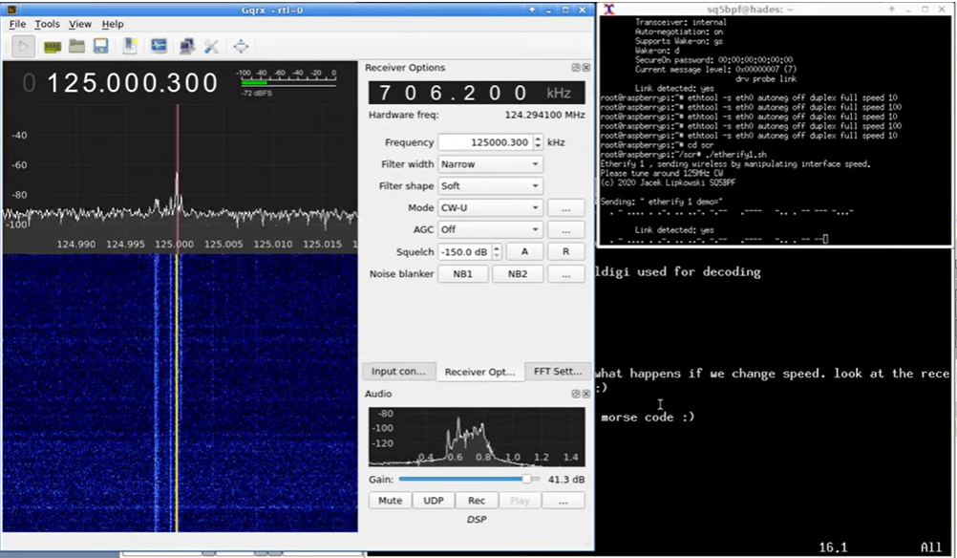
Etherify

Slide 18
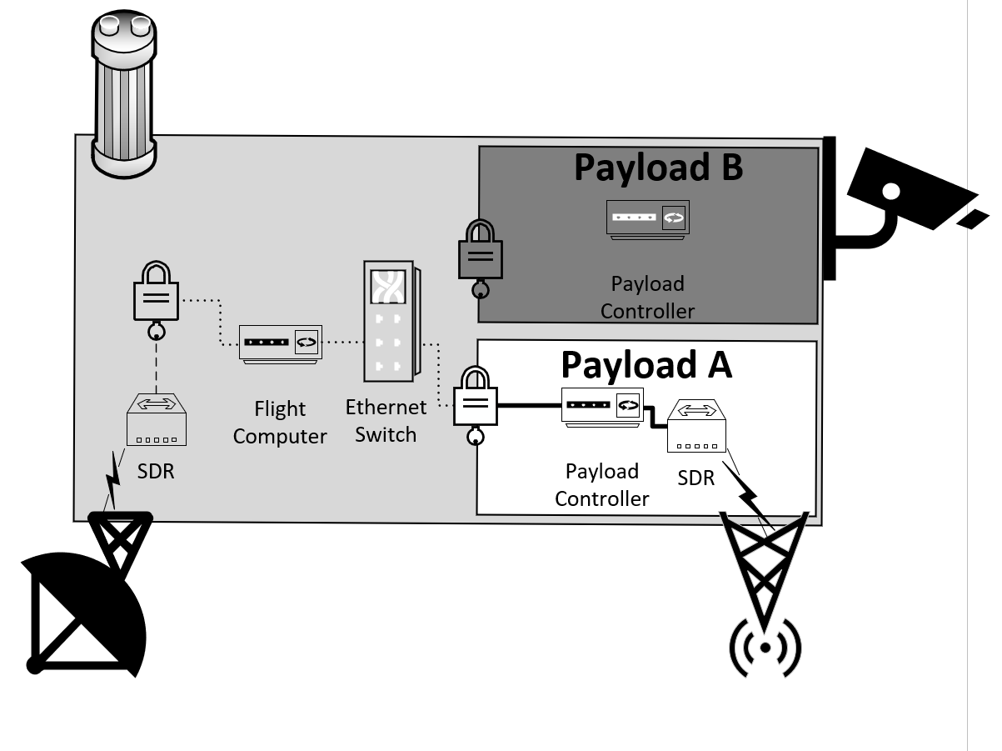

Slide 19
Space Rating STARGATE
Rating resource consumption
Make sure can stay covert and avoid detection by operators monitoring resource utilization
Monitor and reattribute resource utilization reporting to the ground
Command specific risks or measurements
Scheduling activity
Asynchronously
Around aerospace constraints
Data routing
Same as payload? As telemetry? As its own channel? Via attacker ground stations?

Slide 20
What should you test or assess?
An actual satellite before launch
All actual satellites before launch
Flat sat
Digital twin
An orbiting satellite
All orbiting satellites

Slide 21
Value proposition of Pen-Test / Red Team for space
Those pesky problems
Modernization problem – dev’s don’t leverage security functions unless forced to
Disclosure problem – you cant rely on others to tip you to issues
Evaluation problem – case and point
Adaptation problem – exacerbating issue
Cyber warfare problem – adversarial mindset to protect adversaries
Increased commercial entities that own operate and offer services increases potential for extortion, ransom etc
Software supply chain will increasingly become a threat with COTS adaption
Solar Winds / Crowd Strike

Slide 22
Cybersecurity Roles
Data
Detect
Investigate
Systems
Create
Operate
Frameworks
Architecture
Compliance
Assessments
Analyze
Emulate

Slide 23
Data Roles & Space: Detect
On the ground = traditional
In space:
May have plenty of storage for extensive logging
Bandwidth competition with mission will prevent pulling down
CPU/ Memory may be capable of onboard analysis
Will likely compete with these as mission resources
Or; will compete with battery utilization
Disclosure problem hurts effectiveness (lack of heuristics etc)

Slide 24
Data Roles & Space: Investigate
On the ground = traditional + telemetry
In space
To start, you don’t get physical access
You may have to reverse engineer ways of doing system forensics as engineers will not think to need them as it relates to hacking activity
Your now competing with mission activity with each command or comms window you use to threat hunt or do forensics
Most motivation & targeting by adversaries will likely be to disable or steal the asset so this will compound the disclosure issue as you don’t get post mortem

Slide 25
System Roles & Space
Create
Long system development lifecycles
Environmental constraints
Rad hardened (HW shielding / SW CONOPS)
‘space rated’
Faults & avoidance
Operational constraints
Have to understand aerospace / system engineering and other industry specifics
Operate
Competing with mission resources to conduct typical system operations
Have to understand aerospace / system engineering and other industry specifics

Slide 26
Frameworks Roles & Space
Architecture
Think back to the architecture discussion
Compliance
RMF not good enough
Treating space systems as ‘appliance’
Good luck getting IVAV cycles / meeting windows for scans etc

Slide 27
Assessment Roles & Space
Analyze
Requires space industry cultural understanding to convey analysis
Requires very unique niche system understanding
Emulate
Despite our value proposition;
Where do you learn how to pentest these systems safely?
Where do you learn how to represent adversarial tradecraft adequately?
Where do you learn how to tell the right scary story

Slide 28


Infinite and Finite Games

Slide 29

Cybersecurity is an Infinite Game

Slide 30
Cultural Shift
The Cost benefit of Ransomware
Ransoming a big (MGM, Ceasers) is a bet
Ransoming many littles is more opportunistic
Maersk & NotPetya; you don’t even need to be the intended target
A change in terminology
A move towards resilience
A challenge in IV&V

Slide 31
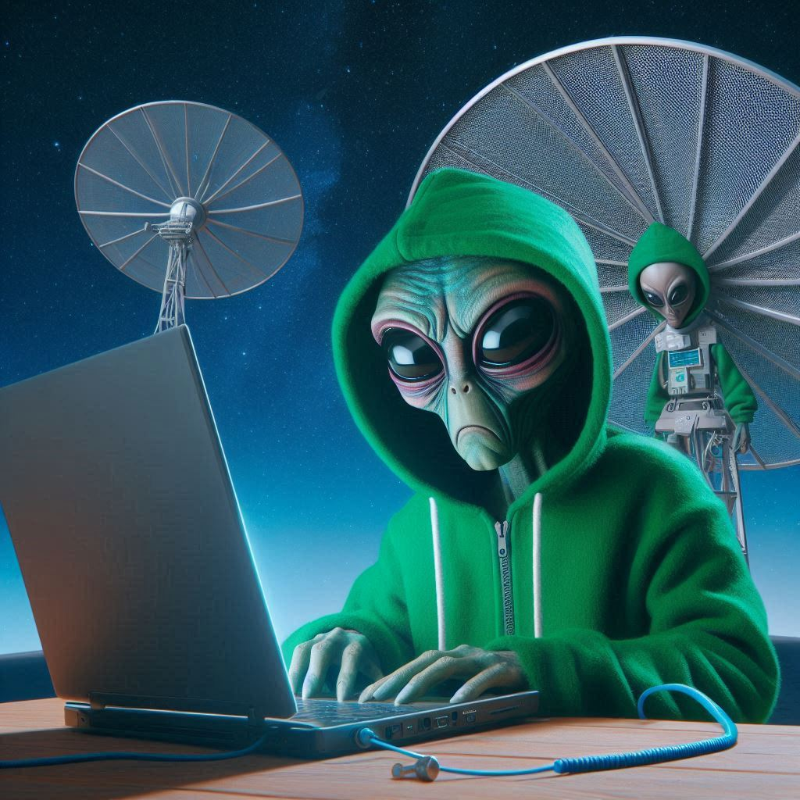
Infinite cyber and space systems
Due to that theft potential, space may never be in a position of accepting and surviving compromise
On the other hand, space engineering has a hyper focus on resilience and redundancy from a non cybersecurity perspective so it could also be considered suited to the infinite

Slide 32
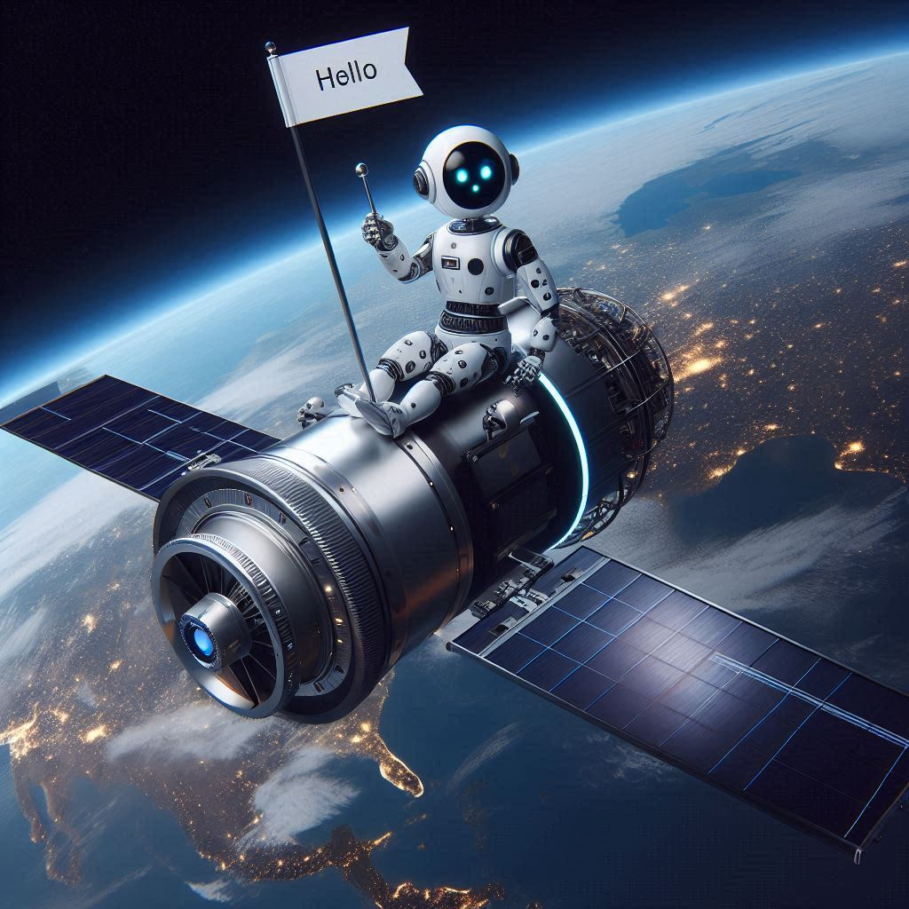
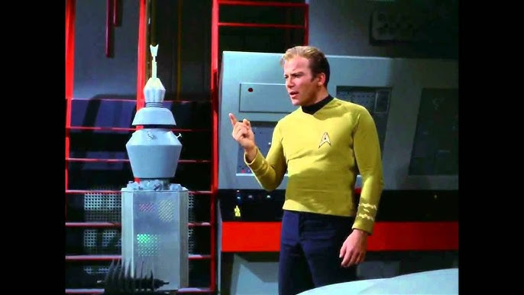
Automation / AI / ML and SV’s
Execute missions with less need for commanding
Problems can grow faster, go longer and be less correctable
Introduces completely new attack surface
Discussion

Slide 33

Maximizing Cost Benefit
Fixing the warm squishy center

Slide 34
A path forward for cybersecurity in space
Need to get past cybersecurity requirements and standards that can / are serviced by Engineers
Cybersecurity as part of the engineering process
The issue of demand signal may never be enough to service the niche
Personal motivation, organizational culture that will drive excellence vs industry demand
Cybersecurity for space will probably only be normalized once space is just like the internet, or cell phones, a taken for granted facet of everyday life

